Slide 1


Introduction to
Shared Libraries
Federico Naum
Sydney Jenkins Meetup 19th July, 2017
Notes:
My name is Federico Naum, I work for animal logic in the Research and Development team as a software toolchain lead, We have a team of 35 developers in Sydney and15 in Vancouver.
Among other tools I maintain our Jenkins instances, keep them up to date, integrate it with other tools, and to the best of my knowledge I provide advice about best practices.
1

Slide 2

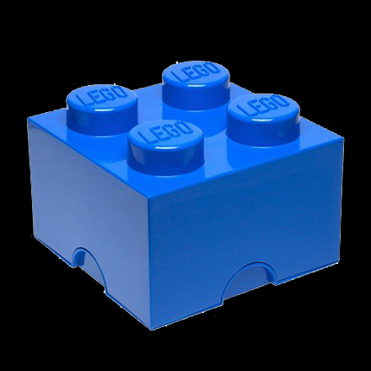
About Animal Logic
Digital animation, visual FX studio
Independent Australian company
Studios in Sydney and Vancouver
Film dev. and production hubs in LA & Sydney
This year we finished our work on:
The LEGO Batman Movie
Guardians of the Galaxy Vol 2
Alien: Covenant (2017)
We are currently in production on:
The LEGO Ninjago Movie (2017)
Peter Rabbit (2018)
The LEGO Movie Sequel (2019)
Notes:
2

Slide 3
Notes:
We are going to watch a short video now with the final product of what we do at AL
Demo reel

Slide 4

Jenkins at AL
Jenkins for 8 years
Pipelines for 1 year
Shared Libraries for 4 months
~400 active Jenkins jobs
15% are using pipelines
Notes:
Pretty cool stuff.. Hopefully I got you attention for the last 3 minutes… I don’t know how I’m going go do that for the remaining 57 minutes.
But let me start by giving you
To give you a bit of CONTEXT
At Animal we have been using Jenkins for the last eight years
Pipelines and Share libraries have been there for a while (at least from 2014/2015), but only a year ago when Jenkins 2.0 was out and pipeline as code was introduced we started using pipelines and we have actively using Shared Libraries for about 4 months now.
So, today is about sharing our experience (quoting) in Shared Libraries.
I’ll assume everybody is familiar with jenkins, but before I go on, Can I know:
Who is using Jenkins pipelines?
Who has attended or watched Malcom’s awesome presentation.
And last one. Who is currently using shared pipelines?
(what is your name?)
Let’s make this presentation interactive, so feel to interrupt at any point and ask questions that will be answered by NAME
4

Slide 5
Agenda
Why Shared Libraries
Configuration and Options
Library Structure
Usage
Modification Workflow
Lessons Learnt
Notes:
This is Wildstyle one of our superheros, her critical mission today will be to make sure I don't start rumbling and I stick to the agenda, so we can finish up on time for beer and pizza
5

Slide 6
Agenda
Why Shared Libraries
Configuration and Options
Library Structure
Usage
Modification Workflow
Lessons Learnt
Notes:
I have to say that before “pipelines as code” and shared libraries we hit several limitations with Jenkins and we had to create some man in the middle and lots of with glue code to meet our needs.
We were even thinking in finding a replacement, but I have to say that things have improved a lot since Jenkins 2. We have removed many of those workarounds and we are enjoying the benefits of pipelines in general.
6

Slide 7

Why Shared Libraries
Abstract Complexity
Notes:
One of the point why we need it to abstract and encapsulate complexity.
COMPLEXITY
Again, to give you some context, counting the 3rd parties libraries, the major 3D packages we use, and our in house code libraries and tools, we have over a thousands interdependent different pieces software packages.
In average, we release about 50 packages a day, and collectively we have more than 15.000 versions that we need to manage.
This is
7

Slide 8
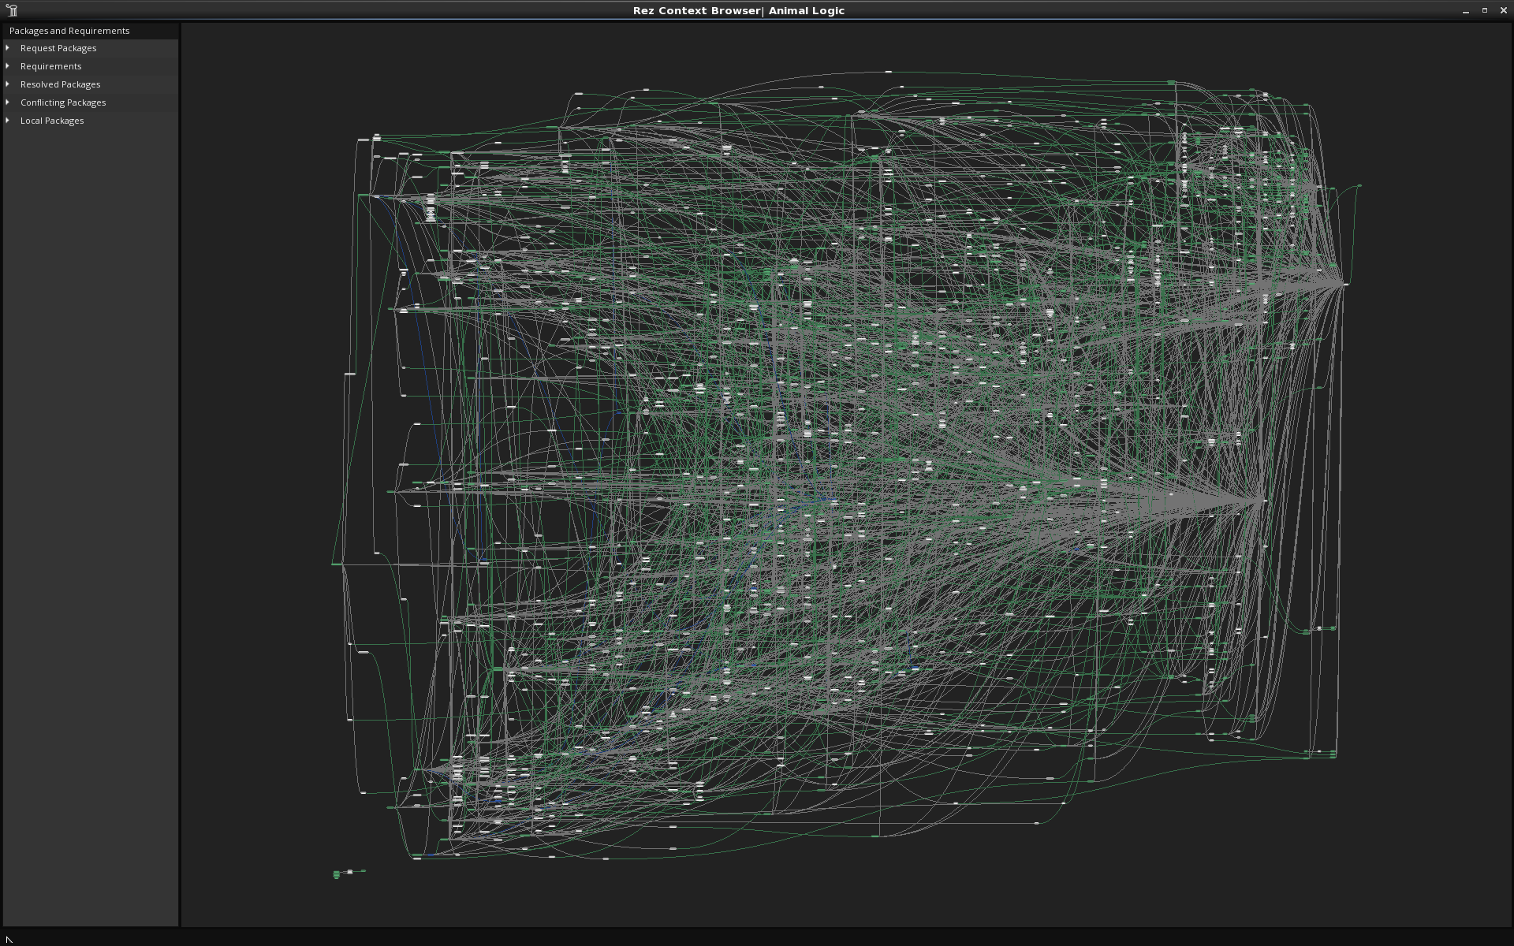
Notes:
The following is an example of an environment to run Maya and get a render of these superheroes.
Our software toolchain is complex we have a lot of software with interdependencies…. In a giving environment there are more than 300 different software packages
Probably off topic, but if you want to know we manage this mayhem with a tool called rez if someone is interested on knowing more fell free to talk to me after the presentation

Slide 9
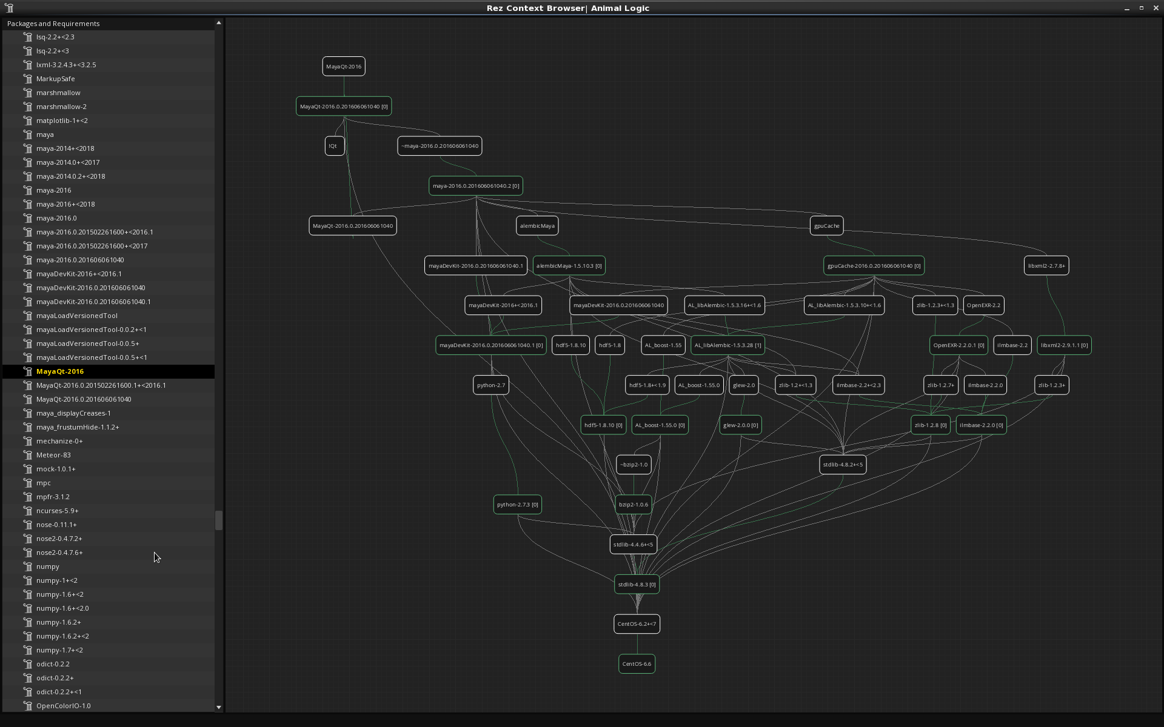
Notes:
This is another view of selecting just one tool and its dependencies
Sooooo, when we modify one piece of software we have to make sure we rebuild and tests all the dependencies as well.

Slide 10
Why Shared Libraries
Abstract Complexity
Build
UT
IT
Deploy
Notes:
So to get to the the text book Build a library -> Run UT -> Run Integration Test - > deploy
You would guess that we have to encapsulate lots of complexity in each step. Shared Libraries are a good fit for this.
10

Slide 11
Why Shared Libraries
Abstract Complexity
Maintainability
Promote code reuse
Avoid code duplication
Notes:
MANTAINABILITY
It guess this apply to everybody.
The same thing you do with c ++, java, python code is to create a library (a dll or dso file) so you want to write it once and have multiple pieces of software using it.
Jenkins pipelines now are code as well (either pure groovy or declarative pipeline but there are code in the end) so we want to reuse it and avoid writing the same thing twice, right?
Next one up
11

Slide 12
Why Shared Libraries
Abstract Complexity
Maintainability
Promote code reuse
Avoid code duplication
Global changes
Apply changes to all pipeline jobs
Notes:
Apply changes to all pipelines jobs at once. This one was quite important for us.
Before we started using Shared Libraries, one of limitation we hit with conventional freestyle jobs (and even with pipelines) was the ability to make changes to all jobs at once.
There is a plugin called slice configuration plugin (has anyone used it?) that allows you to bulk changes of different section of a freestyle job but of course the one you need to change is not available.
Over the years we managed to build test, used and deploy every tool using the same commands, that allow us to create Jenkins jobs that share at lot and give us the ability to apply changes to all jenkins job changing just one flag in one place.
I.E we want to build all jobs now with debug symbols, we change that in the shared library and off you go.
12

Slide 13
Why Shared Libraries
Abstract Complexity
Maintainability
Promote code reuse
Avoid code duplication
Global changes
Apply changes to all pipeline jobs
Avoid monster pipelines
Notes:
And lastly, we want to AVOID unmaintainable monster pipelines.
13

Slide 14

Monster Pipelines
Notes:
Why do I mean by that…In the Lego world giving freedom to create pipelines ends up with something like this ..This is MetalBear you can see he has his parrot in the back, but also has a shark in his right ….quite a hotchpotch..
This is in Lego world,.. In Jenkins pipeline you end up with something like this...
Let’s check .. What we can spot here
No declarative
Scrolling to the end… 350 lines..
Code repetition
Three languages
Double escape
Lots of nesting levels….
Well no need to be genius to know that this is a quite ugly and unmaintainable pipeline
Guess who wrote it? You get a free beer if you get it right
I did it just to make an example of what no to do.
It there is time we can go in how to convert this monster in something readable and more maintainable making use of Shared Libraries.
14

Slide 15

Notes:
LiveSlide Site
https://github.com/AnimalLogic/jenkins_pipeline/blob/master/JenkinsfileRez
15

Slide 16
Agenda
Why Shared Libraries
Configuration and Options
Library Structure
Usage
Modification Workflow
Lessons Learnt
Notes:
Enough reasons I guess, if there are no questions, let’s delve into the configuration.
PAUSE
16

Slide 17

Configuration and Options
Install Pipeline Shared Groovy Libraries plugin
Notes:
First thing you need is to have the Jenkins pipeline Pipeline Shared Groovy Libraries Plugin installed
I assume we do not need to demo that.
17

Slide 18
Configuration and Options
Install Pipeline Shared Groovy Libraries plugin
Two modes:
Legacy mode
single git repo in Jenkins
Notes:
Shared libraries came in two modes
Legacy mode that allos a singe git repo hosted in Jenkins
18

Slide 19
Configuration and Options
Install Pipeline Shared Groovy Libraries plugin
Two modes:
Legacy mode
single git repo in Jenkins
General mode
Any scm (git ,svn, mercurial)
Multiple sources
Notes:
And the general mode.
I can not see any reason why you’ll want to use the legacy mode, so for this presentation we are only going to focus in the General mode only.
[The instruction to use the legacy mode are on a link at the end of the slides.]
19

Slide 20

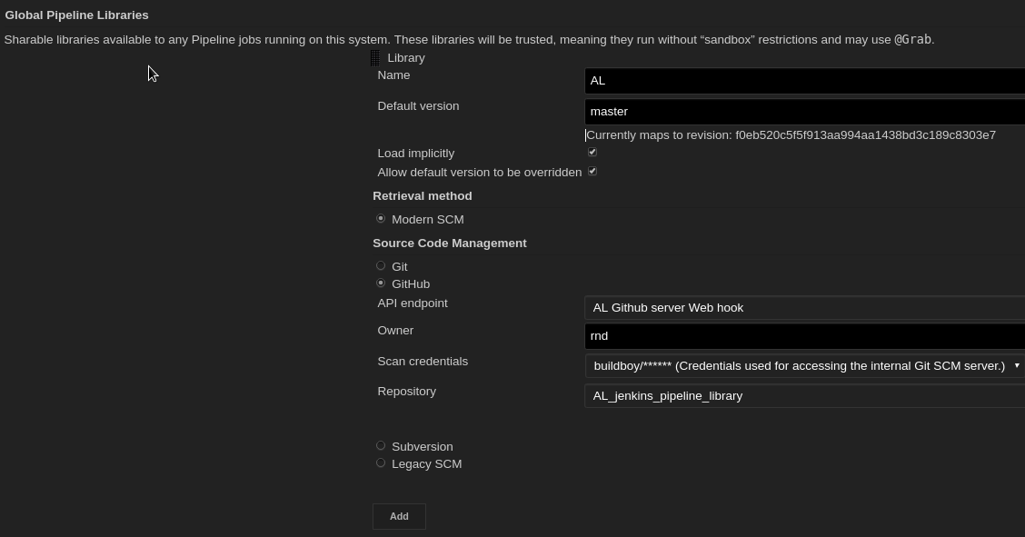
Configuration and Options
Notes:
Explain basic options
20

Slide 21
Configuration and Options
Trusted by default
No option to make it run in a sandbox
Notes:
One particular note here is that these shared pipeline are not sandboxed, so if you have being hitting this annoying thing that need to get approved each groovy “unsafe” method on the In-process Script Approval you will be happy with this. You can encapsulate all those “usafe” calls into a library method and the users of that method
On the other hand, I have to say If your jenkins instance of the code that gets there is as supersecret as the location of the batcave or the real identity of Bruce Wayne. This poses a security concern. People with write access to the pipeline shared repository could gain unlimited access to the jenkins instance.
Explain options
Furthermore, if you specify a version in Jenkins configuration, you can block scripts from selecting a different version
Let’s do some hands on.
Jump to jenkins and use this parameters. User: AnimalLogic Repo: batman_shared_library
We have not setup our Shared library. You can define as many as you want.
Set a library called batman use batman_shared_library repo set to load implicitly (all jenkins pipelies will make a checkout of this repo now)
Create a job in repo AL_Jenkins_pipeline and make it fail 'batmobile_pipe'.
Luckily this gives a descriptive error saying that “ “ (if you are been working with Jenkins pipeline you’ll already know that this is not true all the time, some time the errors are quite obscure)
We live that like this because that bring us to the next slide, What is the library structure
21

Slide 22
Agenda
Why Shared Libraries
Configuration and Options
Library Structure
Usage
Modification Workflow
Lessons Learnt
Notes:
22

Slide 23

Directory structure
(root)
+- src
| └─ al
| └─ foo
| └─ Bar.groovy
+- vars
| └─ fooBar.groovy
| └─ fooBar.txt
+- resources
| └─ org
| └─ al
| └─ bar.py
| └─ foo.bash
Notes:
To be considered a library a repo needs to have this basic structure.
We are going to see examples later, for now I would like just explain what goes en each folder
In SRC
As you can see the src directory resembles Java/groovy source directory structure. This directory gets added to the classpath when executing Pipelines., so you do your imports as you would with any groovy
23

Slide 24
Directory structure
(root)
+- src
| └─ al
| └─ foo
| └─ Bar.groovy
+- vars
| └─ fooBar.groovy
| └─ fooBar.txt
+- resources
| └─ org
| └─ al
| └─ bar.py
| └─ foo.bash
Notes:
VARS
In the vars directory you can store scripts that define global variables and functions that can be accessed from your pipeline
That’s the one that we are using the most, since from our team of 50 developers only fifth are java developers . Most of the people writing pipelines come from python, so not much structured Java, they like to create some global functions and chuck it in there.
To be picked up you need the files to be .groovy.
The matching txt file is optional but I recommend that you always document them because that documentation is displayed in the UI so users can just have a look there to see what is available without the need to look at your groovy code.
The documentation file need to be called the same name as the groovy file and needs to have the txt extension. The contents can be written in HTML or Markdown, but in my experience we were only able to make it work with HTLM (I haven’t tried again with the latest changes)
24

Slide 25
Directory structure
(root)
+- src
| └─ al
| └─ foo
| └─ Bar.groovy
+- vars
| └─ fooBar.groovy
| └─ fooBar.txt
+- resources
| └─ org
| └─ al
| └─ bar.py
| └─ foo.bash
Notes:
In the resources directory, you can add all your non-Groovy files.
Have you used Managed scripts?
In our case we used Managed scripts extensively to write reusable/shareable bash and python helpers. All those non groovy files should end up in this directory. Later we will see a couple of example on how to use this resources.
Now we are gonig to create this file structure (merge branch called file_structure)
25

Slide 26
Agenda
Why Shared Libraries
Configuration and Options
Library Structure
Usage
Modification Workflow
Lessons Learnt
Notes:
26

Slide 27
Usage
 | Global Variables/Functions (vars) | Class library (src) | Resources (resources)
Contents | Any Groovy code | Any Groovy code | Any Non groovy code
Static Invocation (Annotation)
Dynamic invocation (step)
Resolution
Access pipeline steps and env vars directly
Notes:
I try to came up with this table to visualize the differences between the code that goes in each and how they they get used.
27

Slide 28
Usage
 | Global Variables/Functions (vars) | Class library (src) | Resources (resources)
Contents | Any Groovy code | Any Groovy code | Any Non groovy code
Static Invocation (Annotation) | @Library('my-shared-library') _ | @Library(‘rez') import com.al.rez.BuildClass
Dynamic invocation (step)
Resolution
Access pipeline steps and env vars directly
Notes:
This is how to access get the code in global available in your pipeline.
Not is it not fun anymore because it is quite well documented, But it took me an entire day to figure out that this _ was needed.
When referring to class libraries (with src/ directories), conventionally the annotation goes on an import statement:
@Library('somelib')
import com.mycorp.pipeline.somelib.UsefulClass
For Shared Libraries which only define Global Variables (vars/), or a Jenkinsfile which only needs a Global Variable, the annotation pattern @Library('my-shared-library') _ may be useful for keeping code concise. In essence, instead of annotating an unnecessary import statement, the symbol _ is annotated.
It is not recommended to import a global variable/function, since this will force the compiler to interpret fields and methods as static even if they were intended to be instance. The Groovy compiler in this case can produce confusing error messages.
There is a reason for that _ that took it more than a day to figure it out. Currently that notation and the explanation is on the main documentation.
What it says is that instead of annotating an unnecessary import statement, the symbol _ is annotated.
For Class libraries the Annotation goes on an import statement
But when I was re-reading the documentation to create this presentation I found that after one of the release they have created a library step , so you can now at any time in your pipeline call library ‘my-shared-lib’ and after that you can use any method or global variable defined there. ( I tested and works fine)
3) The difference is that in when accessing branches of that library you could for example have something like library "my-shared-library@$BRANCH_NAME”
4) Libraries are resolved and loaded during compilation of the script, before it starts executing. This allows the Groovy compiler to understand the meaning of symbols used in static type checkin
Global Variables however, are resolved at runtime.
Internally, scripts in the vars directory are instantiated on-demand as singletons. This allows multiple methods or properties to be defined in a single .groovy file which interact with each other
5) It feels to me that when you write global functions is like abstracting some common usage in existing pipelines, and code in the class libraries is more like new functionality. But it might be just me. The code in Global functions could look like declarative pipelines where class reassemble more like java code.
28

Slide 29
Usage
 | Global Variables/Functions (vars) | Class library (src) | Resources (resources)
Contents | Any Groovy code | Any Groovy code | Any Non groovy code
Static Invocation (Annotation) | @Library('my-shared-library') _ | @Library(‘rez') import com.al.rez.BuildClass
Dynamic invocation (step) | library 'my-shared-library' | library(’rez’).com.al.rez.BuildClass.builds() | def script = libraryResource(‘al/python/rez/diff_env.py)
Resolution
Access pipeline steps and env vars directly
Notes:
I have create this table to see if we can visualize the diffrence in usage
So how to access it
@Library('my-shared-library') _
/* Using a version specifier, such as branch, tag, etc */
@Library('my-shared-library@1.0') _
/* Accessing multiple libraries with one statement */
@Library(['my-shared-library', 'otherlib@abc1234']) _
When referring to class libraries (with src/ directories), conventionally the annotation goes on an import statement:
@Library('somelib')
import com.mycorp.pipeline.somelib.UsefulClass
For Shared Libraries which only define Global Variables (vars/), or a Jenkinsfile which only needs a Global Variable, the annotation pattern @Library('my-shared-library') _ may be useful for keeping code concise. In essence, instead of annotating an unnecessary import statement, the symbol _ is annotated.
It is not recommended to import a global variable/function, since this will force the compiler to interpret fields and methods as static even if they were intended to be instance. The Groovy compiler in this case can produce confusing error messages.
There is a reason for that _ that took it more than a day to figure it out. Currently that notation and the explanation is on the main documentation.
What it says is that instead of annotating an unnecessary import statement, the symbol _ is annotated.
For Class libraries the Annotation goes on an import statement
But when I was re-reading the documentation to create this presentation I found that after one of the release they have created a library step , so you can now at any time in your pipeline call library ‘my-shared-lib’ and after that you can use any method or global variable defined there. ( I tested and works fine)
3) The difference is that in when accessing branches of that library you could for example have something like library "my-shared-library@$BRANCH_NAME”
4) Libraries are resolved and loaded during compilation of the script, before it starts executing. This allows the Groovy compiler to understand the meaning of symbols used in static type checkin
Global Variables however, are resolved at runtime.
Internally, scripts in the vars directory are instantiated on-demand as singletons. This allows multiple methods or properties to be defined in a single .groovy file which interact with each other
5) It feels to me that when you write global functions is like abstracting some common usage in existing pipelines, and code in the class libraries is more like new functionality. But it might be just me. The code in Global functions could look like declarative pipelines where class reassemble more like java code.
29

Slide 30
Usage
 | Global Variables/Functions (vars) | Class library (src) | Resources (resources)
Contents | Any Groovy code | Any Groovy code | Any Non groovy code
Static Invocation (Annotation) | @Library('my-shared-library') _ | @Library(‘rez') import com.al.rez.BuildClass
Dynamic invocation (step) | library 'my-shared-library' | library(’rez’).com.al.rez.BuildClass.builds() | def script = libraryResource(‘al/python/rez/diff_env.py)
Resolution | At run time | At compile time | At run time
Access pipeline steps and env vars directly
Notes:
I have create this table to see if we can visualize the diffrence in usage
So how to access it
@Library('my-shared-library') _
/* Using a version specifier, such as branch, tag, etc */
@Library('my-shared-library@1.0') _
/* Accessing multiple libraries with one statement */
@Library(['my-shared-library', 'otherlib@abc1234']) _
When referring to class libraries (with src/ directories), conventionally the annotation goes on an import statement:
@Library('somelib')
import com.mycorp.pipeline.somelib.UsefulClass
For Shared Libraries which only define Global Variables (vars/), or a Jenkinsfile which only needs a Global Variable, the annotation pattern @Library('my-shared-library') _ may be useful for keeping code concise. In essence, instead of annotating an unnecessary import statement, the symbol _ is annotated.
It is not recommended to import a global variable/function, since this will force the compiler to interpret fields and methods as static even if they were intended to be instance. The Groovy compiler in this case can produce confusing error messages.
There is a reason for that _ that took it more than a day to figure it out. Currently that notation and the explanation is on the main documentation.
What it says is that instead of annotating an unnecessary import statement, the symbol _ is annotated.
For Class libraries the Annotation goes on an import statement
But when I was re-reading the documentation to create this presentation I found that after one of the release they have created a library step , so you can now at any time in your pipeline call library ‘my-shared-lib’ and after that you can use any method or global variable defined there. ( I tested and works fine)
3) The difference is that in when accessing branches of that library you could for example have something like library "my-shared-library@$BRANCH_NAME”
4) Libraries are resolved and loaded during compilation of the script, before it starts executing. This allows the Groovy compiler to understand the meaning of symbols used in static type checkin
Global Variables however, are resolved at runtime.
Internally, scripts in the vars directory are instantiated on-demand as singletons. This allows multiple methods or properties to be defined in a single .groovy file which interact with each other
5) It feels to me that when you write global functions is like abstracting some common usage in existing pipelines, and code in the class libraries is more like new functionality. But it might be just me. The code in Global functions could look like declarative pipelines where class reassemble more like java code.
30

Slide 31
Usage
 | Global Variables/Functions (vars) | Class library (src) | Resources (resources)
Contents | Any Groovy code | Any Groovy code | Any Non groovy code
Static Invocation (Annotation) | @Library('my-shared-library') _ | @Library(‘rez') import com.al.rez.BuildClass
Dynamic invocation (step) | library 'my-shared-library' | library(’rez’).com.al.rez.BuildClass.builds() | def script = libraryResource(‘al/python/rez/diff_env.py)
Resolution | At run time | At compile time | At run time
Access pipeline steps and env vars directly | YES | NO | N/A
Notes:
I have create this table to see if we can visualize the diffrence in usage
So how to access it
@Library('my-shared-library') _
/* Using a version specifier, such as branch, tag, etc */
@Library('my-shared-library@1.0') _
/* Accessing multiple libraries with one statement */
@Library(['my-shared-library', 'otherlib@abc1234']) _
When referring to class libraries (with src/ directories), conventionally the annotation goes on an import statement:
@Library('somelib')
import com.mycorp.pipeline.somelib.UsefulClass
For Shared Libraries which only define Global Variables (vars/), or a Jenkinsfile which only needs a Global Variable, the annotation pattern @Library('my-shared-library') _ may be useful for keeping code concise. In essence, instead of annotating an unnecessary import statement, the symbol _ is annotated.
It is not recommended to import a global variable/function, since this will force the compiler to interpret fields and methods as static even if they were intended to be instance. The Groovy compiler in this case can produce confusing error messages.
There is a reason for that _ that took it more than a day to figure it out. Currently that notation and the explanation is on the main documentation.
What it says is that instead of annotating an unnecessary import statement, the symbol _ is annotated.
For Class libraries the Annotation goes on an import statement
But when I was re-reading the documentation to create this presentation I found that after one of the release they have created a library step , so you can now at any time in your pipeline call library ‘my-shared-lib’ and after that you can use any method or global variable defined there. ( I tested and works fine)
3) The difference is that in when accessing branches of that library you could for example have something like library "my-shared-library@$BRANCH_NAME”
4) Libraries are resolved and loaded during compilation of the script, before it starts executing. This allows the Groovy compiler to understand the meaning of symbols used in static type checkin
Global Variables however, are resolved at runtime.
Internally, scripts in the vars directory are instantiated on-demand as singletons. This allows multiple methods or properties to be defined in a single .groovy file which interact with each other
5) It feels to me that when you write global functions is like abstracting some common usage in existing pipelines, and code in the class libraries is more like new functionality. But it might be just me. The code in Global functions could look like declarative pipelines where class reassemble more like java code.
31

Slide 32
Usage Examples
Global functions variables:
Global function
Notes:
32

Slide 33
Notes:
LiveSlide Site
https://github.com/AnimalLogic/AL_shared_pipeline_presentation/blob/usage_examples/vars/sonar.groovy
33

Slide 34
Usage Examples
Global functions variables:
Global function
Steps
Notes:
34

Slide 35
Notes:
LiveSlide Site
https://github.com/AnimalLogic/AL_shared_pipeline_presentation/blob/usage_examples/vars/sonarPRAnalysis.groovy
35

Slide 36
Usage Examples
Global functions variables:
Global function
Steps
DSL
Notes:
36

Slide 37
Notes:
LiveSlide Site
https://github.com/AnimalLogic/AL_shared_pipeline_presentation/blob/usage_examples/vars/sonarPRAnalysis.groovy
37

Slide 38
Usage Examples
Global functions variables:
Global function
Steps
DSL
Class library
Notes:
38

Slide 39
Usage Examples
Global functions variables:
Global function
Steps
DSL
Class library
Resources
Notes:
39

Slide 40
Notes:
LiveSlide Site
https://github.com/AnimalLogic/AL_shared_pipeline_presentation/tree/usage_examples/resources/al
40

Slide 41
Notes:
LiveSlide Site
https://github.com/AnimalLogic/jenkins_pipeline/blob/master/JenkinsfileRez
41

Slide 42
Usage
Convert Frankenstein pipeline to declarative using Shared Libs
Notes:
Highlight trick to run bash
Trick to run python
42

Slide 43
Notes:
LiveSlide Site
https://github.com/AnimalLogic/jenkins_pipeline/blob/master/JenkinsfileRez
43

Slide 44
Usage
Convert Frankenstein pipeline to declarative using Shared Libs
Create declarative structure
Enclose all non-step code in scripts {} DIRECTIVE
Move all non-groovy code to resources and us loadResources
Extract commonalities and create global functions in var
Notes:
Highligh trick to run bash
Trick to run python
44

Slide 45
Notes:
LiveSlide Site
https://github.com/AnimalLogic/jenkins_pipeline/pull/1/files?diff=split
45

Slide 46
Usage
Convert Frankenstein pipeline to declarative using Shared Libs
Create declarative structure
Enclose all non-step code in scripts {} DIRECTIVE
Move all non-groovy code to resources and us loadResources
Extract commonalities and create global functions in var
Create steps from the script sections
Notes:
Question here is where to stop
46

Slide 47
Notes:
LiveSlide Site
https://github.com/AnimalLogic/jenkins_pipeline/pull/2/files
47

Slide 48

Hey you!!!
Notes:
Here is Bad cop that is always watching at you!!! And he says !!
48

Slide 49
DOCUMENT
your
Shared Libraries!!
Notes:
DOCUMENTING is quite easy and highly recomended
A variable defined in a shared library will only show up in Global Variables Reference (under Pipeline Syntax) after Jenkins loads and uses that library as part of a successful Pipeline run.
An example of the documentation is as follows
49

Slide 50
Notes:
LiveSlide Site
https://github.com/AnimalLogic/AL_shared_pipeline_presentation/blob/usage_examples/vars/global.txt
50

Slide 51
Agenda
Why Shared Libraries
Configuration and Options
Library Structure
Usage
Modification Workflow
Lessons Learnt
Notes:
51

Slide 52
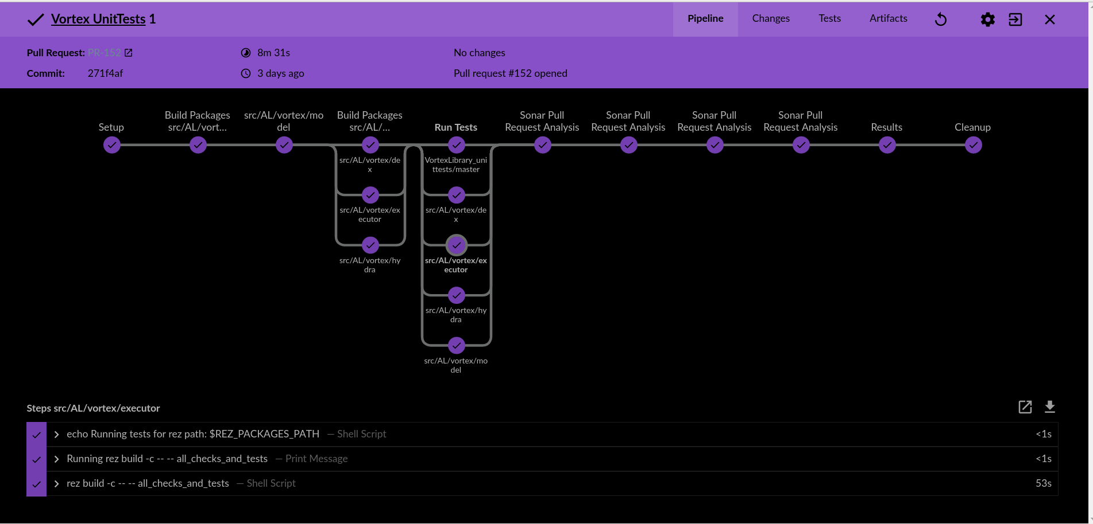
Notes:
Now we have this lovely pipeline
That creates (serial or parallel) stages dynamically based on the tool dependencies,
discover test create some parallel stages with dynamic input steps, umbit jobs to out render farm.. Wait in lightweight executors for a response and once it gets all the results runsome static code analysis and present the results.
This is a model that was all extracted into a shared library and then reused by several other jobs.

Slide 53
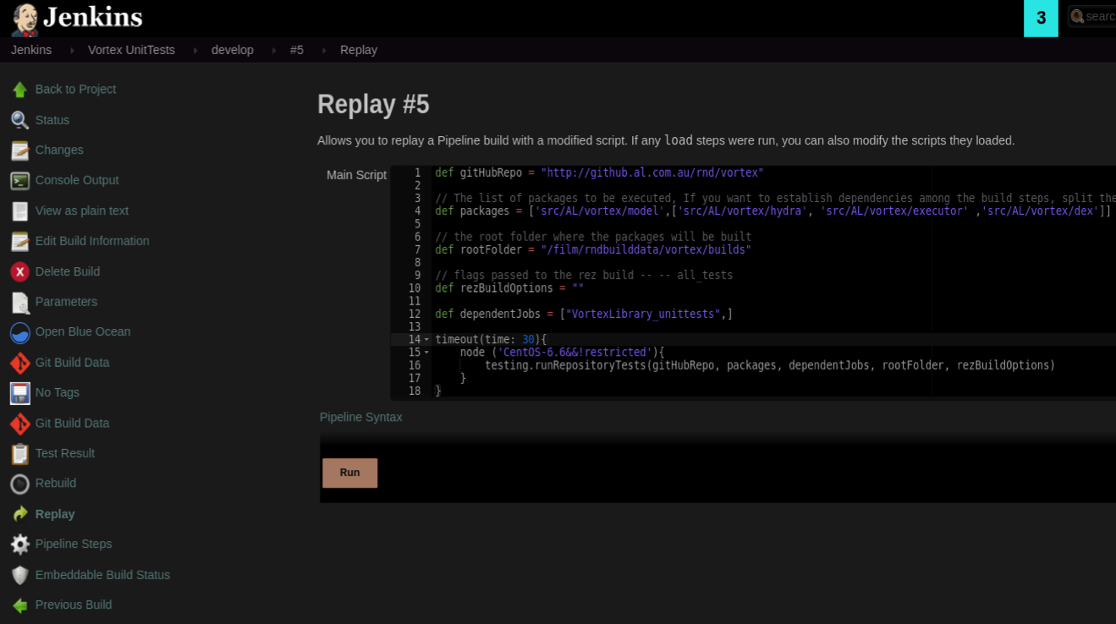
Notes:
This is now the pipeline code needed to generate one of this jobs
…So you say … great …That’s perfect..
But, can you guess what’s the potential problem of this ideal shared code?
Someone makes a change in the library in the master branch …..and….

Slide 54

Notes:
Now all hour beautiful pipelines get destroyed all at once.
54

Slide 55
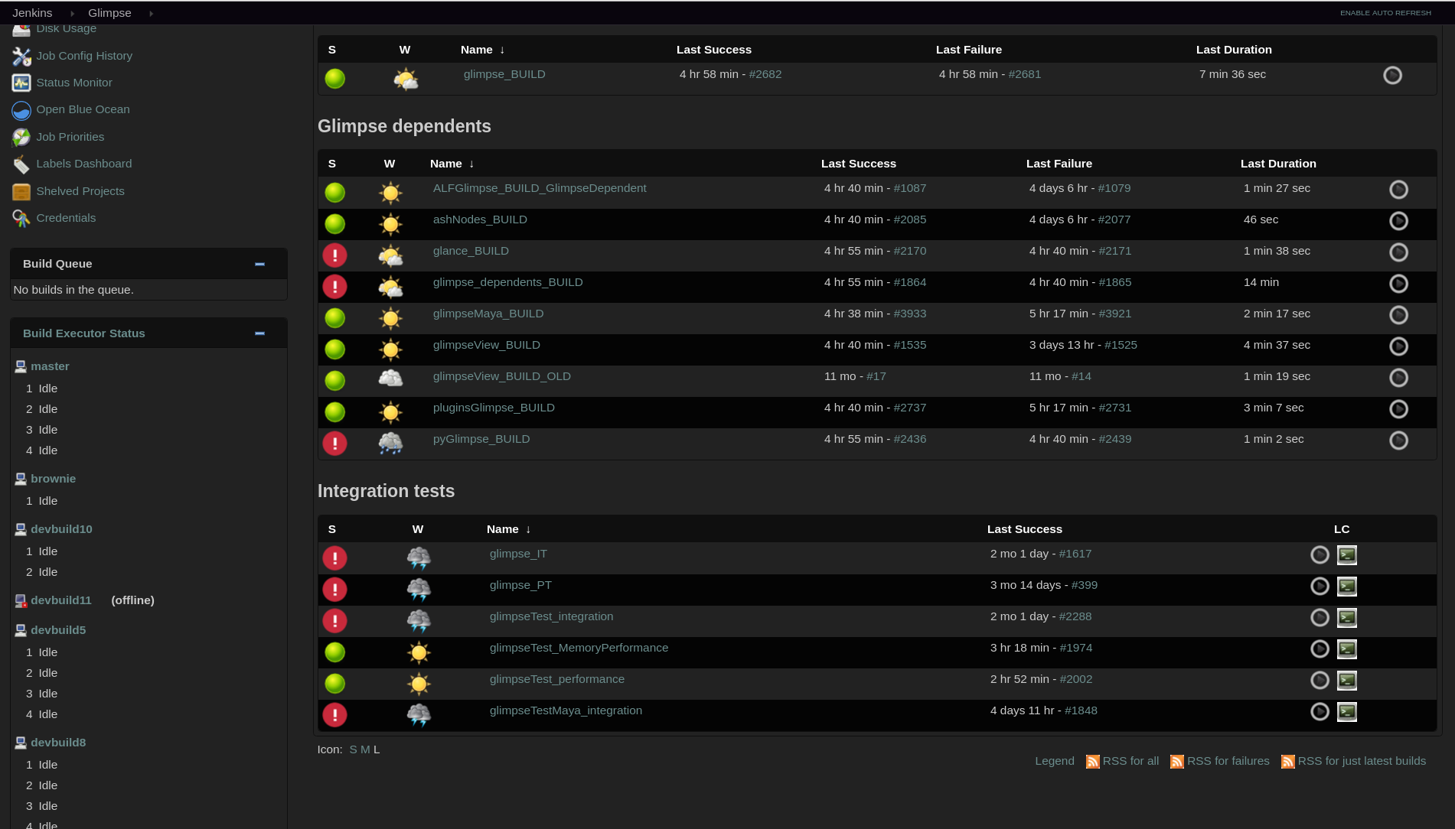
Notes:
You end up with all your lovely green dots in red.
We can not test properly therefore we can not release and people in production trying to make a movie get pretty angry….
…
That’s when you need to introduce a workflow for changing your pipeline

Slide 56

Modification Workflow
Create a branch of you pipeline
Access you modified library with
@Library('lib@branchname') or library 'lib@branchname'
Submit pull request
Get approval
Merge to master
Notes:
This the modification workflow we use.
Other more secure/restrictive way will be in the configuration to set a
Got back and show again the configuration option!!
56

Slide 57
Agenda
Why Shared Libraries
Configuration and Options
Library Structure
Usage
Modification Workflow
Lessons Learnt
Notes:
57

Slide 58

DO
Use Shared Pipelines
Notes:
This is Vitruvious, he has all the cumulative knowledge and is going to share the lesson we have learned with Shared Libraries
I do not know why I waited for a bit, but shared pipelines are awesome, they have leveraged lots of potential for what we can do Jenkins
58

Slide 59
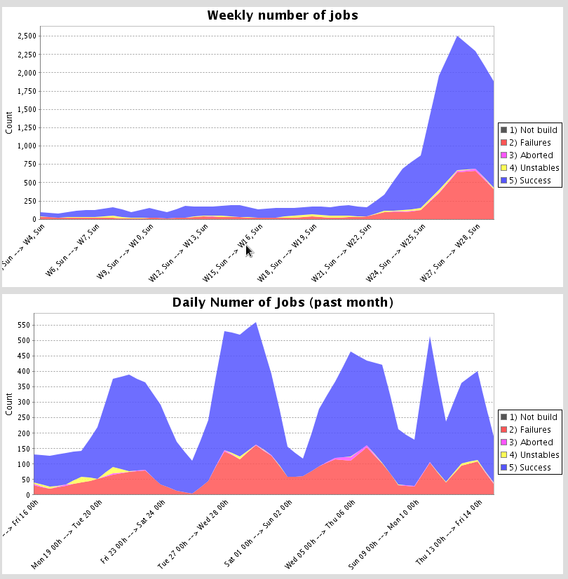
Jenkins stats
Notes:
I just gathered some stats from our Jenkins instance…. With the first graphs I wanted to show the rapid ramp up from when we started using and reusing our Jenkins Shared libraries, we we when from 250 builds a day to 2500, that’s 10 times, and it is going to keep growing.
59

Slide 60
DO
Use Shared Libraries
They are code treat them as such
Notes:
In some way they are configuration of you job but in the end it is code so
Code review it
Refactored them when needed
Document it
You can go as far as testing them.. But that could be too much.
60

Slide 61
DO
Use Shared Libraries
They are code treat them as such
Move your managed scripts into resources and wrap them in steps
Notes:
Workflow use library instead of pipeline editor (in reply) If you are using things from the library that can
They have the potential of destructing all your pipelines at once. And also they pose a security concerns.
61

Slide 62
DO
Use Shared Libraries
They are code treat them as such
Move your managed scripts into resources and wrap them in steps
Use the linter when coding shared libraries
Notes:
Workflow use library instead of pipeline editor (in reply) If you are using things from the library that can
They have the potential of destructing all your pipelines at once. And also they pose a security concerns.
62

Slide 63
DO
Use Shared Libraries
They are code treat them as such
Move your managed scripts into resources and wrap them in steps
Use the linter when coding shared libraries
When using reply workflow. Copy the code in the clipboard before running it
Notes:
If for some reason you are pasting your global library in the reply in order to test something quick
Make sure you copy that first because if it fails with a compilation error you won’t be able to reply again.
63

Slide 64
DO NOT
Allow direct commits to master
Notes:
Or you are going to learn the hard way, if you are reusing heavily it has the potential to break lots of pipes.
64

Slide 65
DO NOT
Allow direct commits to master
Import global variables
Notes:
If you do variables/functions became static …Even if they were intended to be instance. The Groovy compiler can produce confusing error messages.
Use the _ at the end of the library directive
65

Slide 66
GOTCHAS
Libraries name are case sensitive
Linter won’t catch error of your Shared library
PR not triggering the first time you add a Jenkinsfile, it needs to exists in the base branch
Reply does not take the parameter from the current pipeline but from the previous build
Notes:
1) I was trying something for this presentation, that new dynamic invocation of the pipeline. I was validating my pipelines with the linter but I lost several hours
2) The linter does not expand like an import you global function, the are resolve at runtime, so the linter won’t catch errors. But as I mentioned earlier you can run the linter in you non-declarative pipeline and it would do a groovy check before giving you the error that it does not have a pipelines statement.
3) When you have a parameterized job, and you change in your pipeline the default values , if your are pasting that in the replay box, and changing , they won’t take place, but the parameter of the previous build will be used.
4) This is more normal pipeline but it got mw
66

Slide 67
links
https://jenkins.io/doc/book/pipeline/shared-libraries/
https://wiki.jenkins.io/display/JENKINS/Pipeline+Shared+Groovy+Libraries+Plugin
https://github.com/jenkinsci/workflow-cps-global-lib-plugin
https://jenkins.io/doc/book/pipeline/
Notes:
Most of what I said today you’ll find it on these links that I’m including.
But it wont be that fun because they do not have there pretty pictures.
67

Slide 68
Back up slides
Discuss:
Folder-level Shared Libraries
Dynamic retrieval of libraries
Notes:
Folder-level Shared Libraries
Any Folder created can have Shared Libraries associated with it. This mechanism allows scoping of specific libraries to all the Pipelines inside of the folder or subfolder.
Folder-based libraries are not considered "trusted:" they run in the Groovy sandbox just like typical Pipelines.
Dinamic retrieval
Usually you define in Jenkins your shared libraries, but there is a way to retrieve a shared library dynamically without jenkins know about it. The syntax is hard to remmeber you can look that in the documentation. We haven’t had the need to use it. But I have it on the back of my mind in case someone propose me an use case. Like this.
68

Slide 69
Backup slide
Discuss,
Notes:
Workflow use library instead of pipeline editor (in reply) If you are using things from the library that can
They have the potential of destructing all your pipelines at once. And also they pose a security concerns.
69

